Slide 1


Statistical & Predictive Analysis
of Song Popularity
STREAMING
STREAMING
STREAMING
ADVAITH S RAO
AYUSH OTURKAR
FALGUN MALHOTRA
HSIAO-CHUN HUNG (JEANIE)
VANSHITA GUPTA

Slide 2
OBJECTIVE
40
Song Popularity----->
30
To build a robust regression model to predict the popularity of a song based on several attributes like energy, acoustics, tempo, liveness, danceability.
To test different hypotheses based on features impacting it.
20
10
0
Audio Feature X------>

Slide 3
DATASET: Spotify Audio Features
ARTIST NAME
KEY
LIVENESS
TRACK ID
LOUDNESS
TRACK NAME
MODE
ACOUSTICNESS
SPEECHINESS
DANCEABILITY
TEMPO
DURATION
VALENCE
ENERGY
TIME SIGNATURE
INSTRUMENTALNESS
POPULARITY
*Audio features for 130k tracks collected from the official Spotify Web API

Slide 4
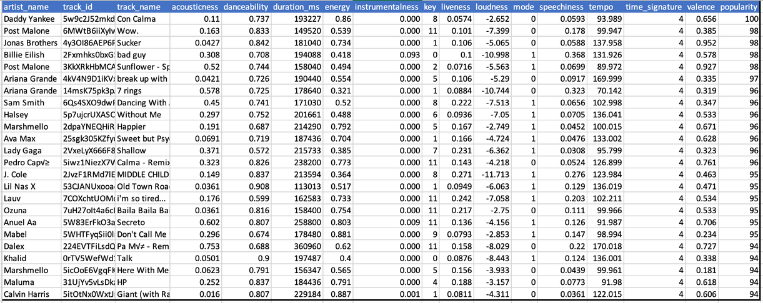
DATASET SNAPSHOT:
STREAMING
STREAMING
STREAMING
This is the dependent variable

Slide 5





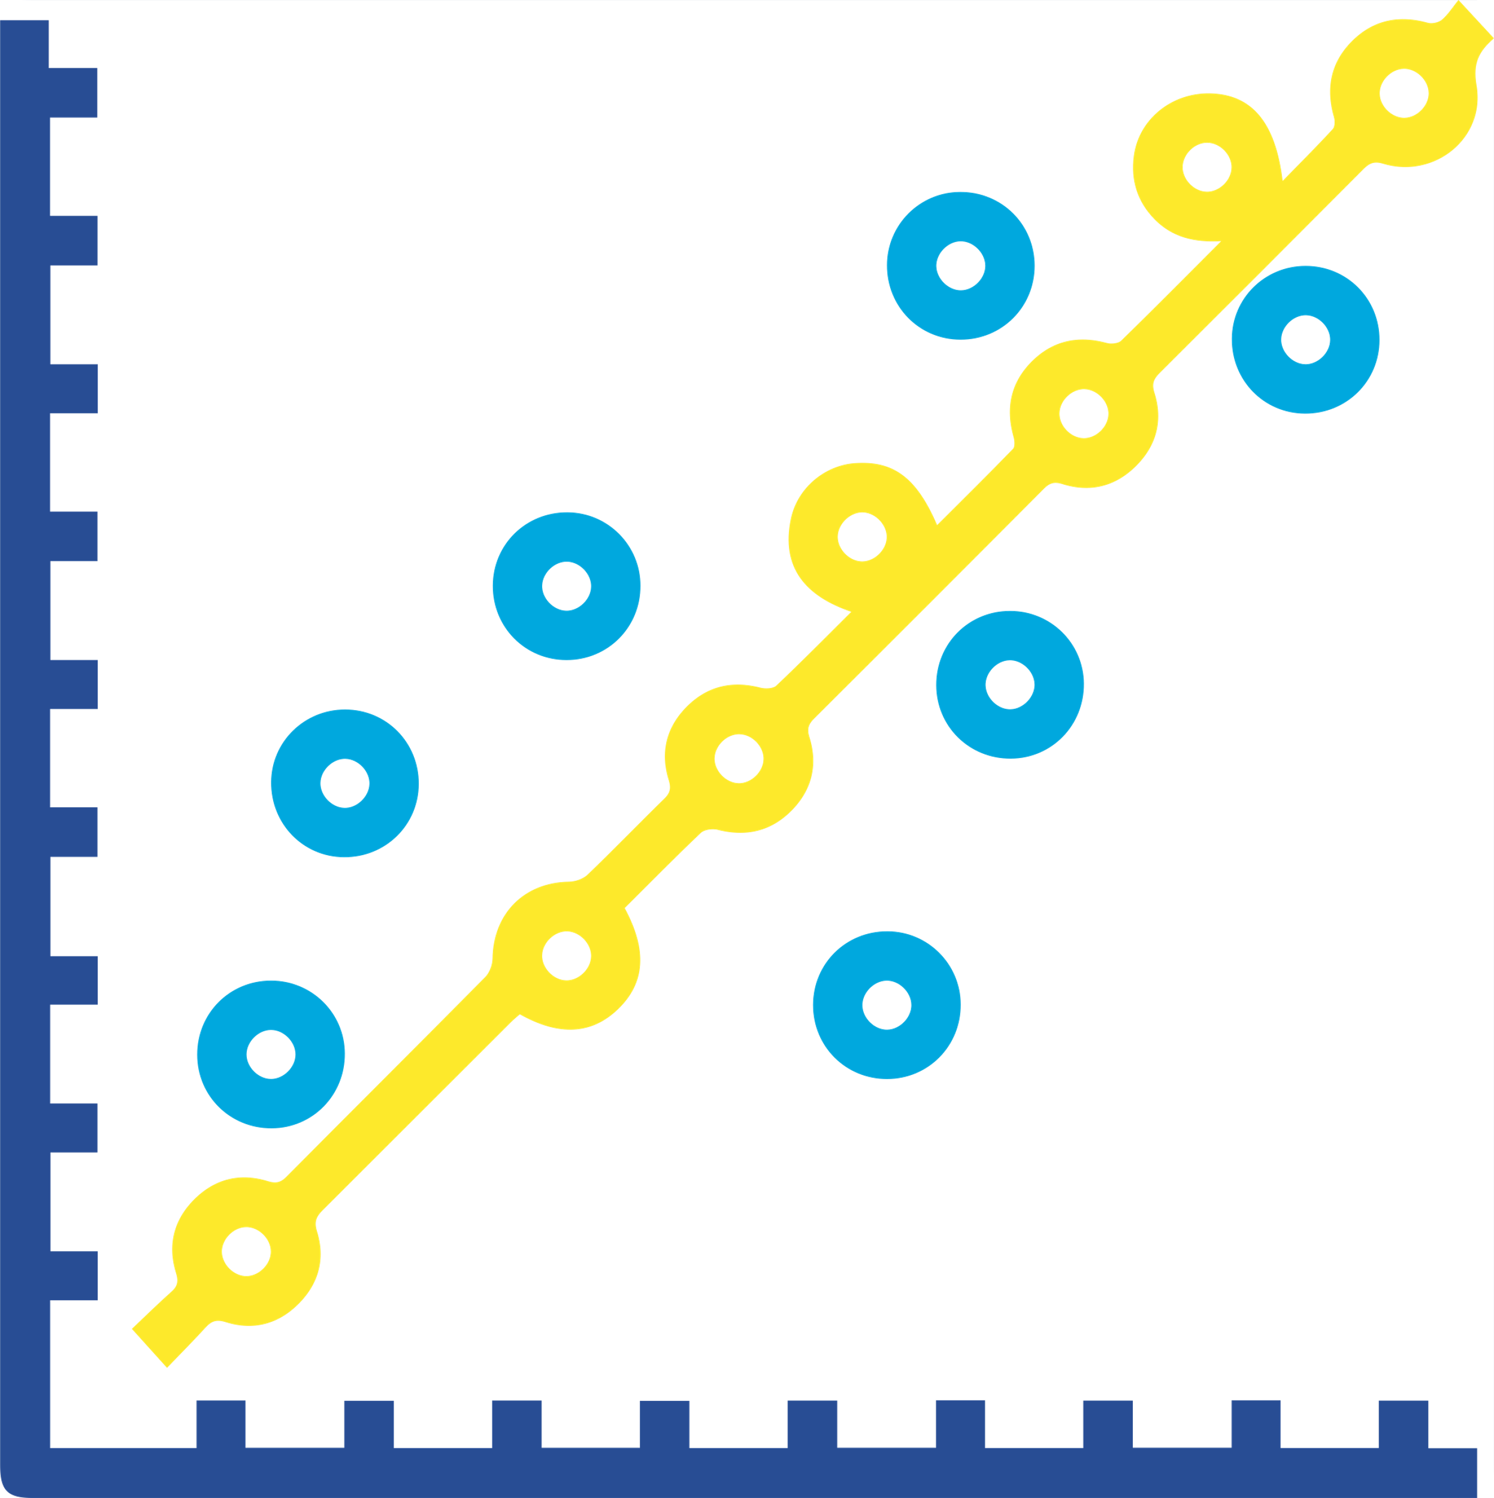

PROJECT ROADMAP
Exploratory Data Analysis
Data
Cleaning
Hypothesis Testing
Data Preprocessing
Feature Engineering
Modeling
Observations, Future scope

Slide 6
DATA PREPROCESSING
Duplicate Data Treatment
337 duplicate track ids were detected within the dataset. Only the first one is considered for each track id.
Outlier Removal
Song Duration < 1 min
Song Duration > 10 mins
Speechiness > 0.66
Liveness < 0.8
Tempo = 0
Time Signature = 0
Popularity = 0

Slide 7
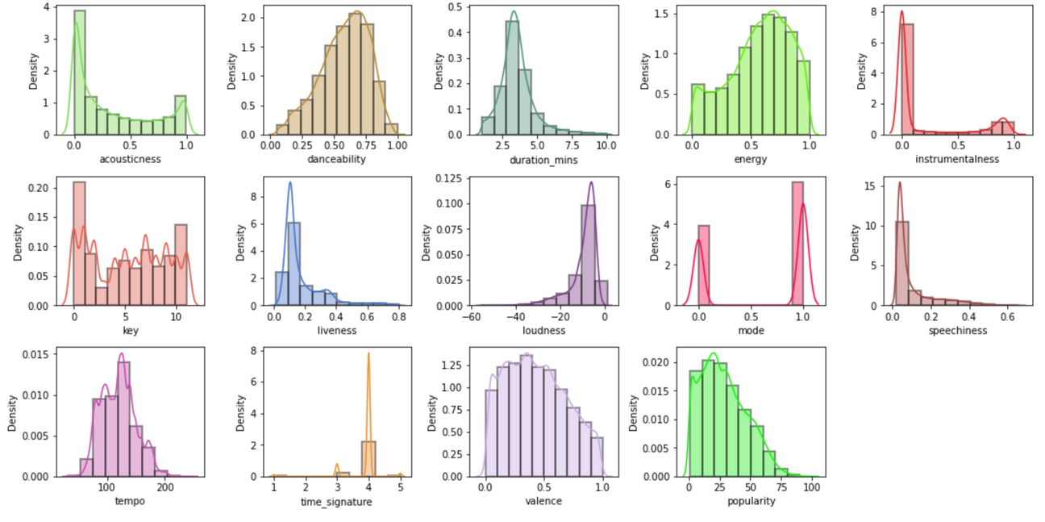
NUMERIC DISTRIBUTION OF AUDIO FEATURES FOR ALL SONGS
STREAMING
STREAMING
STREAMING

Slide 8
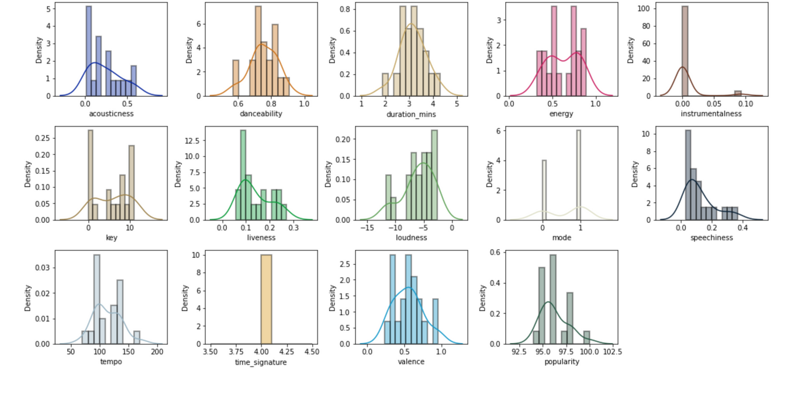
NUMERIC DISTRIBUTION OF AUDIO FEATURES FOR TOP 20 SONGS
STREAMING
STREAMING
STREAMING

Slide 9
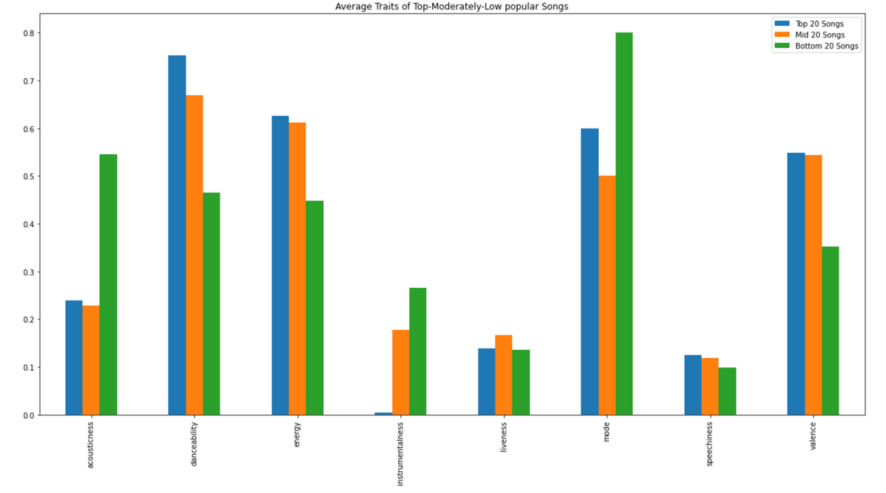
COMPARISON OF FEATURE AVERAGES FOR TOP, MID & BOTTOM 20 SONGS
STREAMING
STREAMING
STREAMING

Slide 10
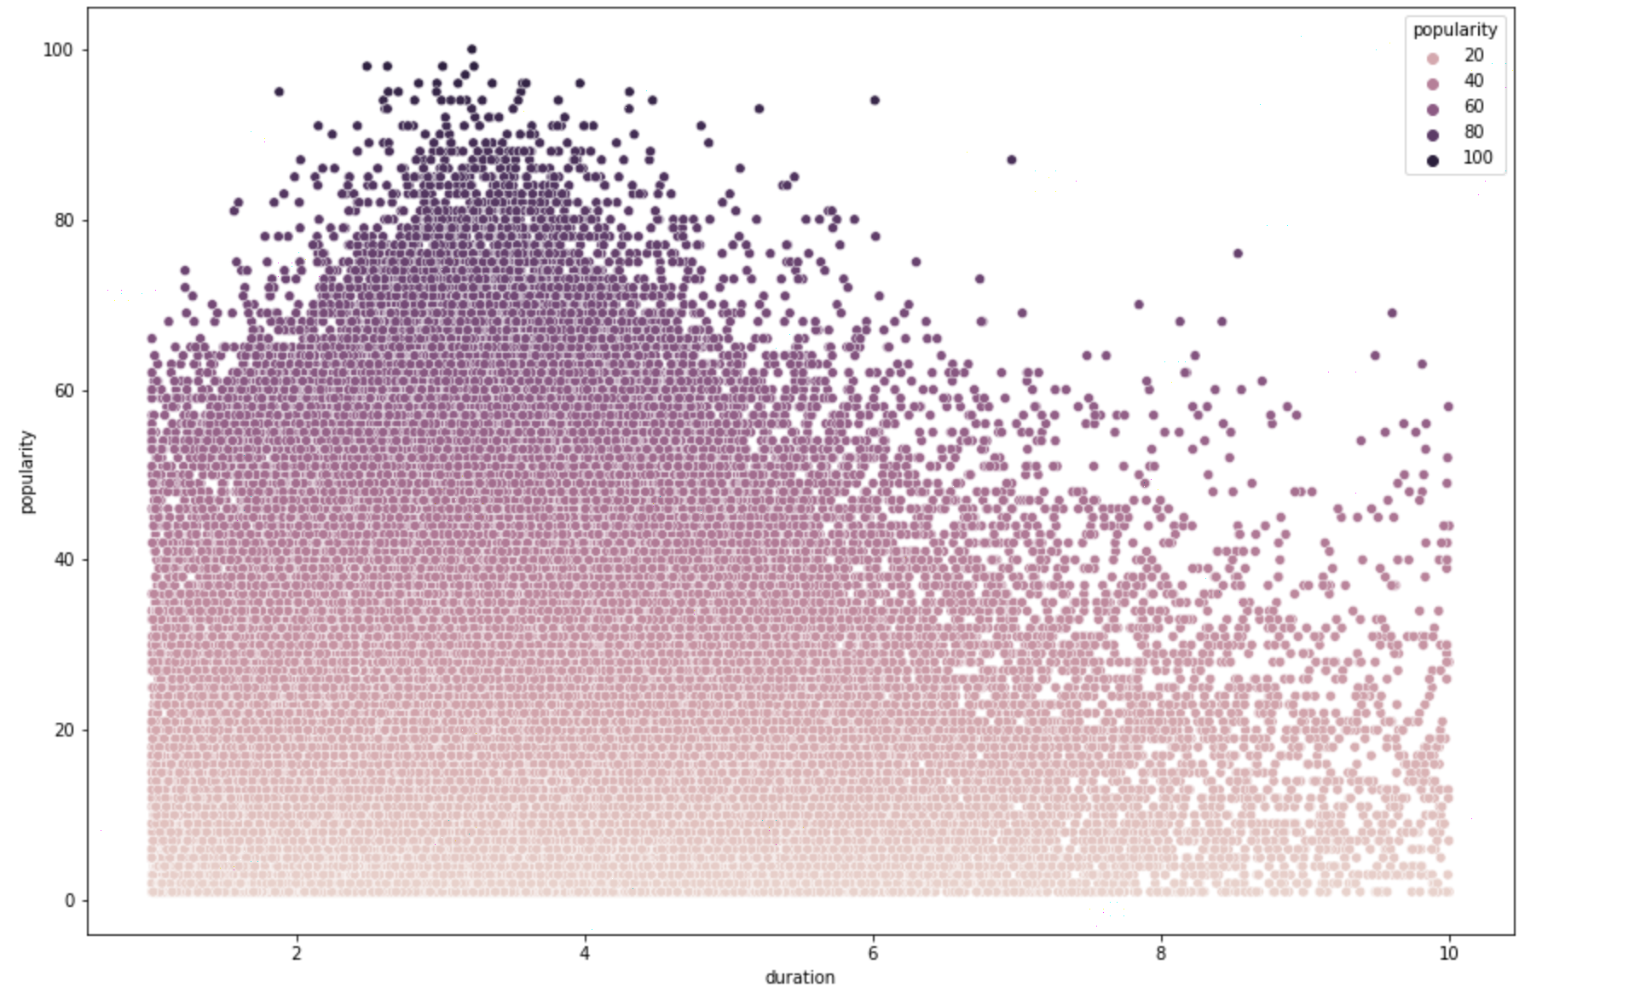
SONG DURATION VS POPULARITY
STREAMING
STREAMING
STREAMING

Slide 11
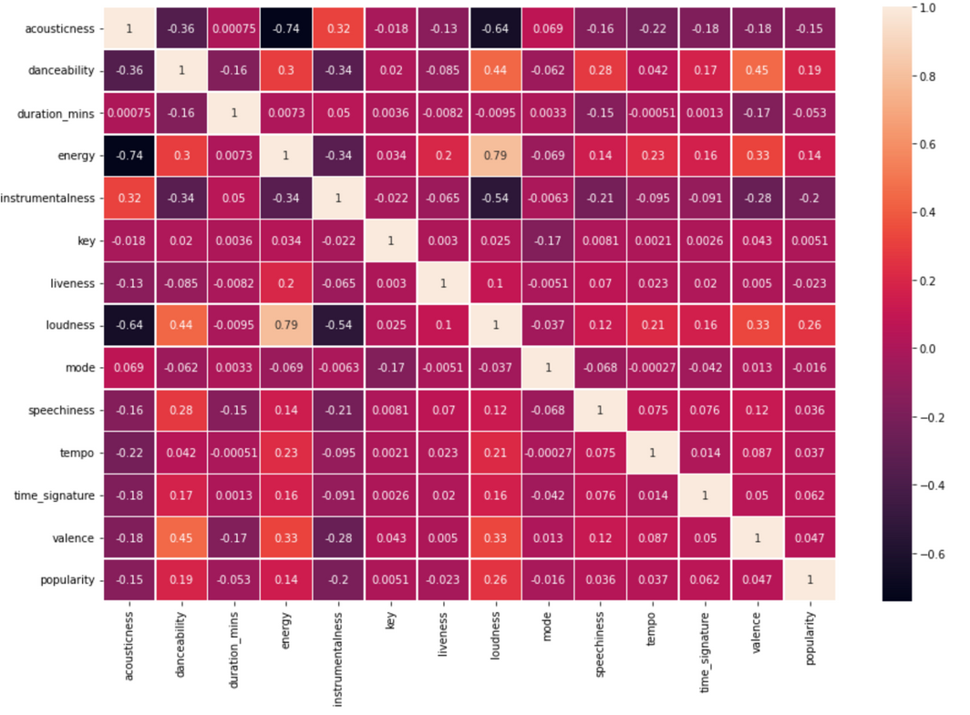
CORRELATION MATRIX BETWEEN ALL AUDIO FEATURES
STREAMING
STREAMING
STREAMING

Slide 12
New features :
IS NEW ARTIST?
This feature is based on the total track count per artist. If the total song count is 1, we consider artist to be new and feature value becomes 1, else 0.
FEATURE ENGINEERING
POPULAR KEY
This feature is based on the feature 'key'. If the key is C, C#, G#, B (0,1,8,11), we consider it to be a popular key and our feature value becomes 1, else 0.
NOISE LEVEL
This feature is created using 0.5 * difference between 'energy' and 'acousticness'.

Slide 13
Steps Include :
DROPPING FEATURES BASED ON VARIANCE INFLATION FACTOR
'loudness', 'danceability', 'energy', 'acousticness', 'key', and 'time_signature' were dropped.
TRACKS REMOVAL BASED ON REGEX
DATA CLEANING
Tracks were removed intuitively. Track names including one of the following keywords were removed:
'mix, rain, podcast, intro, outro, DJ, sleep'
FEATURE BINNING
The 'Tempo' feature was put into buckets based on thresholds.
< 75: -1
76-120: 0
> 120: 1

Slide 14
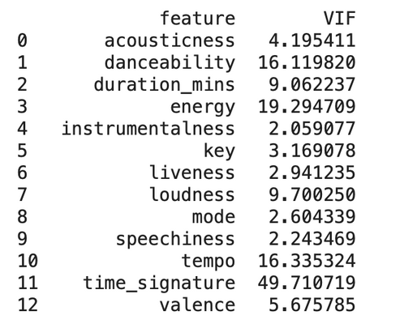
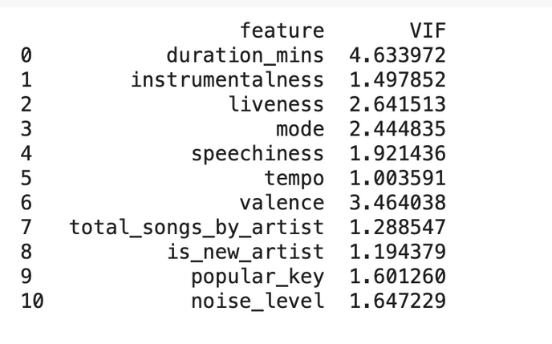
MULTICOLLINEARITY ANALYSIS AND TREATMENT:
Before
After
STREAMING
STREAMING
STREAMING

Slide 15

40
30
20
10
MODELING ENGINE
MODELING ENGINE
MODELING ENGINE
MODELING ENGINE
0
0
10
20
30
40
ORDINARY LEAST SQUARES
A vanilla OLS model was implemented initially. To make it adhere to linear regression assumptions, log and box-cox transformations were performed on data.

Slide 16
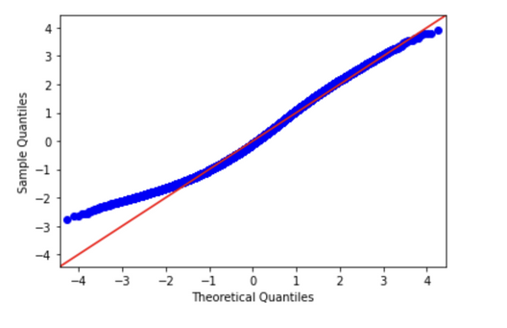
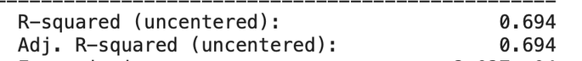
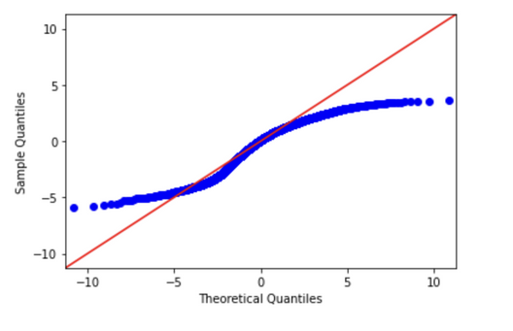
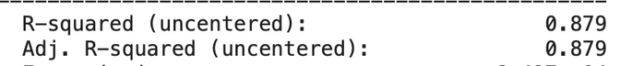
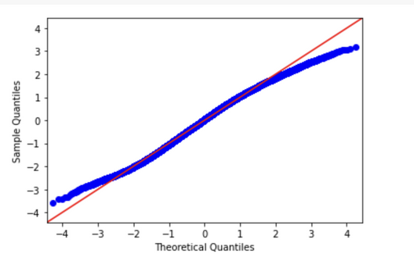
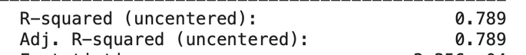
PERFORMANCE AND QQ PLOTS
Vanilla OLS Model
OLS with Log Transformation
STREAMING
STREAMING
STREAMING
OLS with Box-Cox Transformation

Slide 17
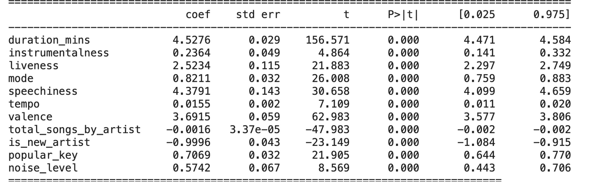
BETA COEFFICIENTS AND
P-VALUES FOR THE BEST MODEL
STREAMING
STREAMING
STREAMING

Slide 18
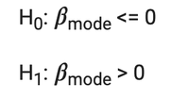
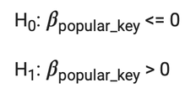
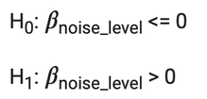
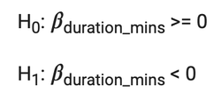
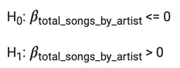
HYPOTHESIS
TESTING
SONGS IN MAJOR MODE ARE MORE POPULAR THAN ONES IN MINOR
FOR A SONG TO BE POPULAR, WE NEED IT TO BE IN A POPULAR KEY
Significance Level taken for different statistical tests:
0.05
p-value is close to 1
FAIL to reject the null hypothesis
Songs in minor mode are more popular
p-value is close to 1
FAIL to reject the null hypothesis
Songs do not have to be in popular key to be popular
SONGS WITH HIGH NOISE ARE MOST POPULAR
MOST PEOPLE LIKE LISTENING TO SONGS OF SHORT DURATION
ARTISTS WITH MORE SONGS ARE MORE POPULAR
p-value is close to 1
FAIL to reject the null hypothesis
Songs with high noise are not the most popular ones
p-value is close to 0
reject the null hypothesis
The longer the duration, the lesser its likelihood of being popular
p-value is close to 1
FAIL to reject the null hypothesis
An artist with more songs, is not necessarily always more popular

Slide 19

MODELING PERFORMANCE IMPROVEMENTS
Performance of model on test data (20% Split):
Model | RMSE on test set
Best OLS Regressor | 4.44
Random Forest Regressor | 4.03
CatBoost with GridSearch CV | 3.81
STREAMING
STREAMING
STREAMING
Observation:
Cat Boost is the champion model based on RMSE however, explainability is lost as the predictor is a black box function.
*A train-test split of 80-20 was taken for performance checks

Slide 20

FUTURE
SCOPE
OF WORK
Get more samples of data
Gather more variables which help explain the data better such as,
Genre
Recent track popularity
#Playlists for the track
NLP to leverage information out of track name and lyrics
Audio processing to get more features out of the audio data
We could make use of popularity of featured artists

Slide 21

Happy New Year
FUTURE
SCOPE
OF WORK
Happy New Year
Happy New Year
Happy New Year
THANK YOU FOR LISTENING

